Slide 1
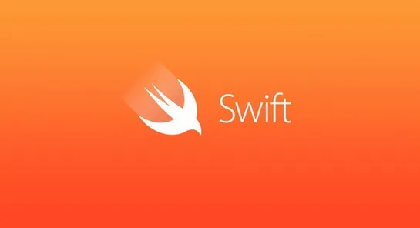
Who Want to Learn Swift?
By Garrick D. Smith

Slide 2
What is Swift
Swift is a high-level general-purpose
multi-paradigm
compiled programming language

Slide 3
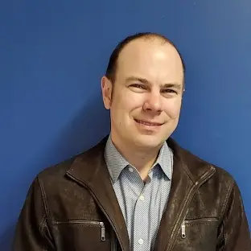
Who created Swift?
Swift was created by Computer Scientist, Christopher Arthur Lattner

Slide 4
Why was Swift was created?
Changed was need
A replacement of Objective- C
Objective-C was used in the early 1980’s until Swift credit in 2014
Objective –C lacked modern language features

Slide 5
How to learned Swift for free?
Freecodecamp: https://www.youtube.com/watch?v=8Xg7E9shq0U
iBook by Apple, Inc: Develop in Swift Fundamentials
Swift Homepage: https://www.swift.org/

Slide 6
Q/A

Slide 7
Sources
Freecodecamp: https://www.youtube.com/watch?v=8Xg7E9shq0U
iBook by Apple, Inc: Develop in Swift Fundamentials
Swift Homepage: https://www.swift.org/
Chris Lattner's Homepage: https://nondot.org/sabre/
Apple Launches Swift,
https://techcrunch.com/2014/06/02/apple-launches-swift-a-new-programming-language-for-writing-ios-and-os-x-apps/

Slide 8
Thank you for listening Go And Learn, Swift

